Slide 1

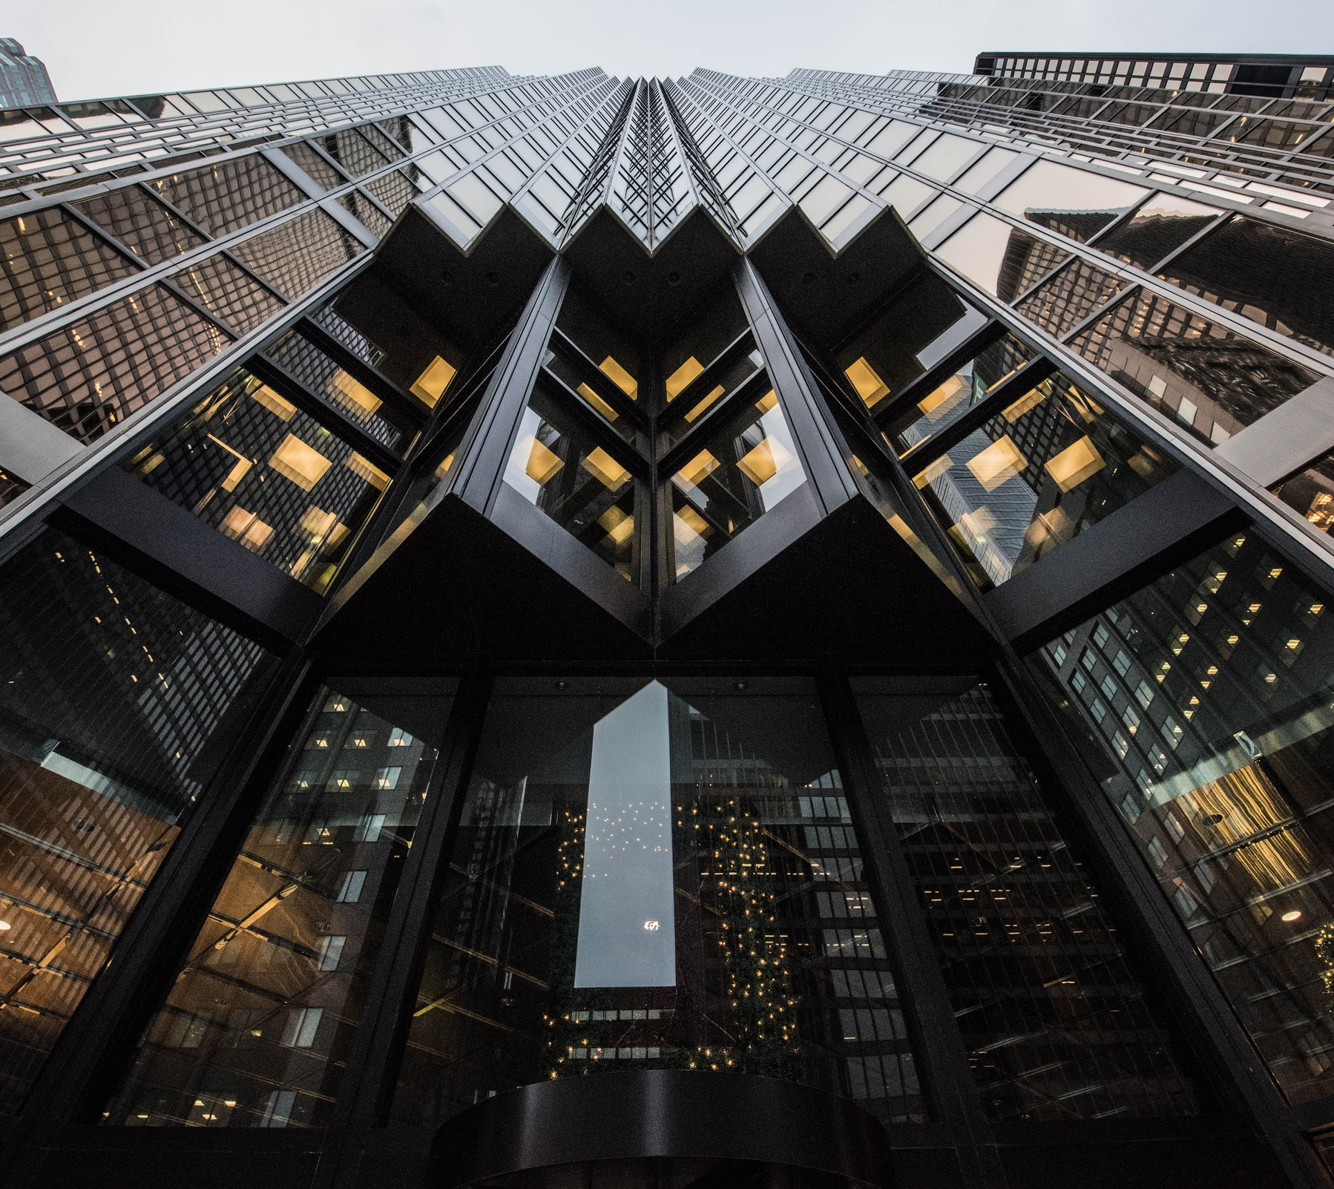

THE UNIVERSITY OF HONG KONG
DEPARTMENT OF COMPUTER SCIENCE
1
Blockchain-Based Land Registration System
FITE2010 PROJECT PRESENTATION
APRIL 25, 2024
PROFESSOR: DR. LIU, QI
GROUP MEMBERS:
AHMED, MASOOD (3035812127)
RAHMAN, MOHAMMAD ABDUR (3035756579)

Slide 2

2
CONTENTS
Introduction
2. Our Solution
Blockchain-Based Land Registration System
3. Methodology
4. Demo
5. Considerations
6. Challenges
7. Future
Prospects
8. Conclusion

Slide 3

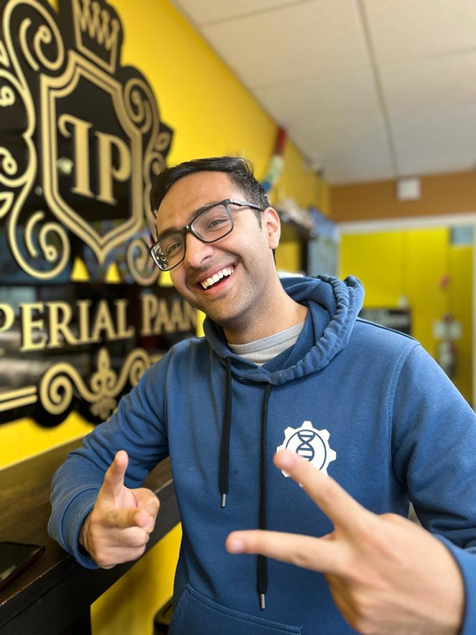
3
THE TEAM
RAHMAN, Mohammad Abdur
AHMED, Masood
INTRO
SOLUTION
METHODOLOGY
LIVE DEMO
CONSIDERATIONS
CHALLENGES
CONCLUSION

Slide 4







5
PROBLEM DEFINITION
Opportunities with BlockchainTechnology
Legal uncertainties and complexities in property transactions
Reliable, decentralized, transparent and secure land registration system.
Inconvenience and Higher costs
Adoption of smart contracts on public blockchain platforms
Difficulty in secure storage of paper deeds
EXISTING LAND REGISTRATION SYSTEM CHALLENGES IN HONG KONG
Potential for enhancing security and maintenance of land data
INTRO
SOLUTION
METHODOLOGY
LIVE DEMO
CONSIDERATIONS
CHALLENGES
CONCLUSION
Notes:
Challenges:
1. Associated with Legal uncertainties and complexities in property transactions as there is no digital land registry for easy access of record. Document inspections, often occurring after the buyer and seller have entered into the final sales agreement, can lead to delays and uncertainties.
2. inconvenience and high costs of examining and verifying property titles through solicitors.
3. . Difficulty in secure storage of paper deeds. Storing paper deeds raises security concerns, as these physical documents are susceptible to damage from environmental factors such as fire, floods, or pests.
how we leveraged blockchain technology to solve these problems:
1. We have built a reliable, decentralised, transparent and secure land registration system
2. we made use of smart contracts on public blockchain platforms to automate property transactions
3. The decentralised nature of blockchain will enhance security and maintenance of land data

Slide 5
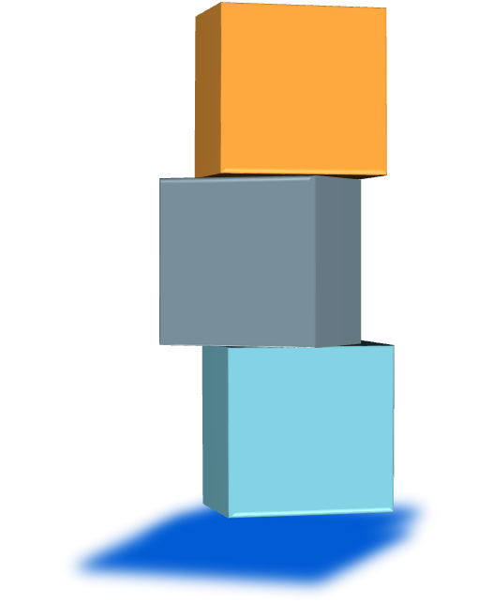






6
PROJECT OBJECTIVES
ESTABLISH A
BLOCKCHAIN-BASED
LAND REGISTRY
AUTOMATE PROPERTY TRANSACTIONS
ENSURE
DATA SECURITY AND
PRIVACY
INTRO
SOLUTION
METHODOLOGY
LIVE DEMO
CONSIDERATIONS
CHALLENGES
CONCLUSION

Slide 6
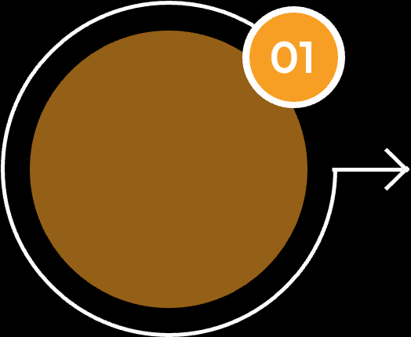
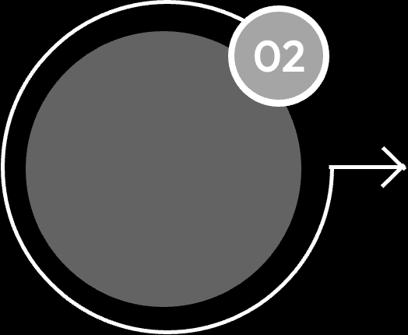
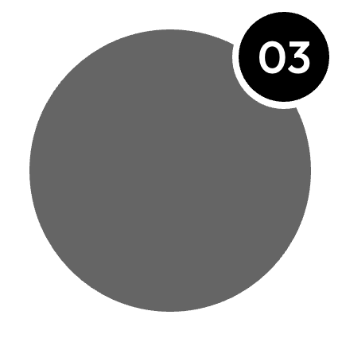
7
PROJECT DELIVERABLES
Front-End
Application
Smart
Contracts
Documentation
Buyer dashboard
Land Inspector
dashboard
Seller dashboard
Land Registration
Contract
Smart Contract
Component
Code
INTRO
SOLUTION
METHODOLOGY
LIVE DEMO
CONSIDERATIONS
CHALLENGES
CONCLUSION

Slide 7

7
OUR SOLUTION
WHY WILL IT WORK?
Expanded Market Participation and Liquidity
Operational Efficiency
Enhanced Security and Compliance
Digitizing land registration on blockchain broadens market access and streamlines transactions, simplifying investment entry and boosting liquidity.
Smart contracts automate processes, reduce manual errors and intermediaries, speeding up transactions and cutting costs while real-time updates enhance decision-making.
Blockchain's immutable ledger and decentralized validation secure records and reduce fraud, while smart contracts ensure regulatory compliance by embedding legal and procedural rules directly into transactions.
INTRO
SOLUTION
METHODOLOGY
LIVE DEMO
CONSIDERATIONS
CHALLENGES
CONCLUSION

Slide 8
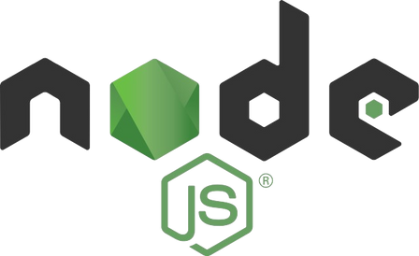


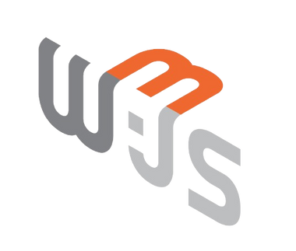


8
TECH STACK
Blockchain Platform and Smart Contracts:
Ethereum: Offers advanced smart contracts and strong developer support for secure, automated transactions.
Solidity: Primary language for reliable and efficient smart contracts on Ethereum.
Development Environment:
Ganache: A personal blockchain for Ethereum development that allows for easy testing and simulation of blockchain conditions locally.
Frontend and User Interface:
React: JavaScript library selected for responsive and flexible UI development, optimized for blockchain interactions.
Backend and API Integration:
Node.js: Chosen for its event-driven architecture, ideal for efficient real-time applications on distributed systems.
LIVE DEMO
LIVE DEMO
CHALLENGES
INTRO
CHALLENGES
INTRO
SOLUTION
SOLUTION
METHODOLOGY
METHODOLOGY
CONSIDERATIONS
CONSIDERATIONS
CONCLUSION
CONCLUSION

Slide 9


9
DIFFERENTIATING FACTOR
1st Blockchain Based
Land Registration System
in Hong Kong
Decentralization
and
Trust
Role of Government
and
Stakeholder Collaboration
Enhanced Security
and
Immutable Data Storage
Efficient Transaction Handling and
Validation
INTRO
SOLUTION
METHODOLOGY
LIVE DEMO
CONSIDERATIONS
CHALLENGES
CONCLUSION
Notes:
Role of government and how our project includes the government as a key stakeholder compared to other solutions which are completely outside govt jurisdiction

Slide 10
10
METHODOLOGY
Blockchain-Based Land Registration System
System Architectural Design
Smart Contract Design
Security Design
Defines the structure, behavior, and more views of a system
Defines the participants, functions, requirements and constraints of smart contract execution.
Defines the security rules associated with transactions. Answers some security questions related.
INTRO
SOLUTION
METHODOLOGY
LIVE DEMO
CONSIDERATIONS
CHALLENGES
CONCLUSION

Slide 11

11
SYSTEM ARCHITECTURAL DESIGN
Decentralized Land Registry: The system utilizes blockchain technology to create a decentralized and tamper-proof land registry. This ensures the reliability of property ownership records.
Buyer Dashboard: This user interface allows potential buyers to view available lands for purchase.
Seller Dashboard: This user interface enables sellers to post lands they are willing to sell.
Land Inspector Dashboard: This user interface allows a land inspector, which is a government entity, to verify lands and authorize sales.
INTRO
SOLUTION
METHODOLOGY
LIVE DEMO
CONSIDERATIONS
CHALLENGES
CONCLUSION

Slide 12


12
SYSTEM ARCHITECTURAL DESIGN
Truffle: Development environment, testing framework, and asset pipeline for Ethereum.
Used to develop and deploy smart contracts for the land registration system.
Helps in coding, compiling, and testing the smart contracts.
Ganache:
Personal blockchain for Ethereum development.
Provides a local blockchain environment for testing and simulating smart contract execution.
Allows developers to test smart contracts before deploying them to a “test” ethereum network.
INTRO
SOLUTION
METHODOLOGY
LIVE DEMO
CONSIDERATIONS
CHALLENGES
CONCLUSION

Slide 13
13
SMART CONTRACT DESIGN
A Smart Contract consists of several key components:
Participants: These are the entities that interact with the contract.
State: This is the current status of the contract.
Functions: These are the operations that the contract can perform.
Rules: These are the conditions that govern how the contract operates.
INTRO
SOLUTION
METHODOLOGY
LIVE DEMO
CONSIDERATIONS
CHALLENGES
CONCLUSION

Slide 14
15
SMART CONTRACT DESIGN
The 4 Main Use Cases:
REGISTER
VERIFY / VIEW
For Land Registration
To verify the authenticity of records
TRANSFER
SELL
Land Transfer
For Property Sales
INTRO
SOLUTION
METHODOLOGY
LIVE DEMO
CONSIDERATIONS
CHALLENGES
CONCLUSION

Slide 15

16
INTERACTIONS
How Different Functions and Events in our system interact.
Add land flow:
addLand(): by seller
approveLand(): by land inspector
Sale flow:
requestLand(): by buyer
approveRequest(): by seller
approveSale(): by land inspector
payment(): by buyer
INTRO
SOLUTION
METHODOLOGY
LIVE DEMO
CONSIDERATIONS
CHALLENGES
CONCLUSION

Slide 16
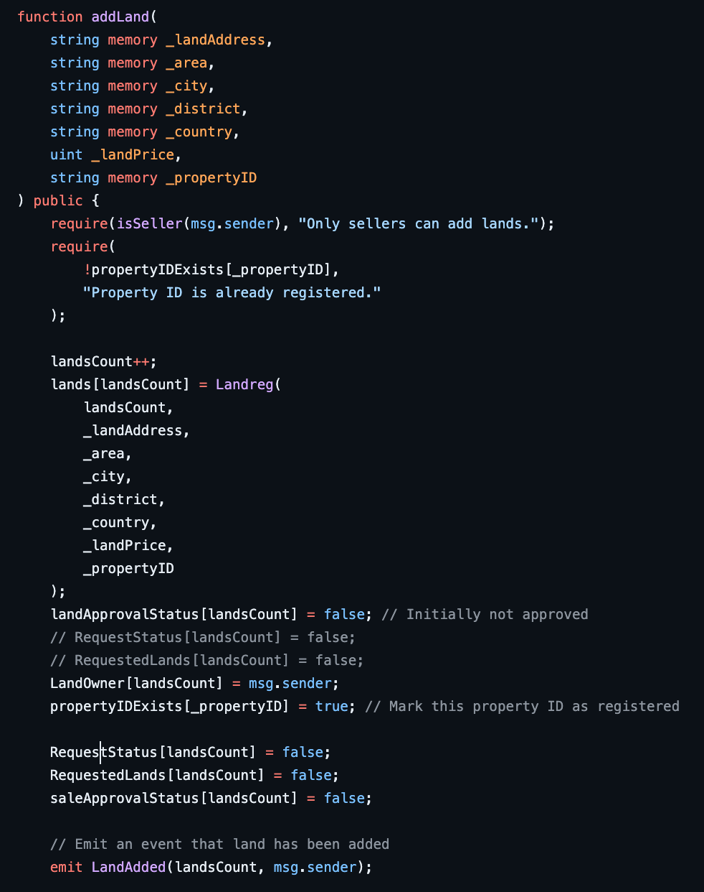
17
1. addLand() allows an address to register a new parcel of land with its location and a unique parcel ID. Emits a LandAdded event when land is registered.
INTRO
SOLUTION
METHODOLOGY
LIVE DEMO
CONSIDERATIONS
CHALLENGES
CONCLUSION

Slide 17
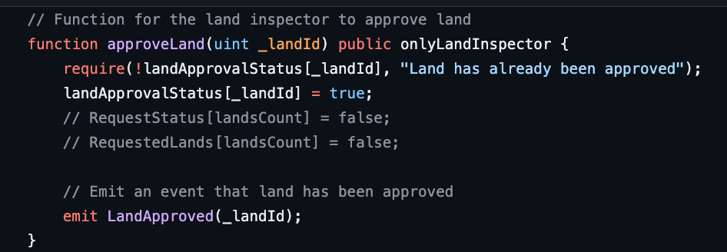
18
2. approveLand() allows the land inspector to property to be added to the blockchain network.
A LandApproved event is emitted when land is approved.
INTRO
SOLUTION
METHODOLOGY
LIVE DEMO
CONSIDERATIONS
CHALLENGES
CONCLUSION

Slide 18
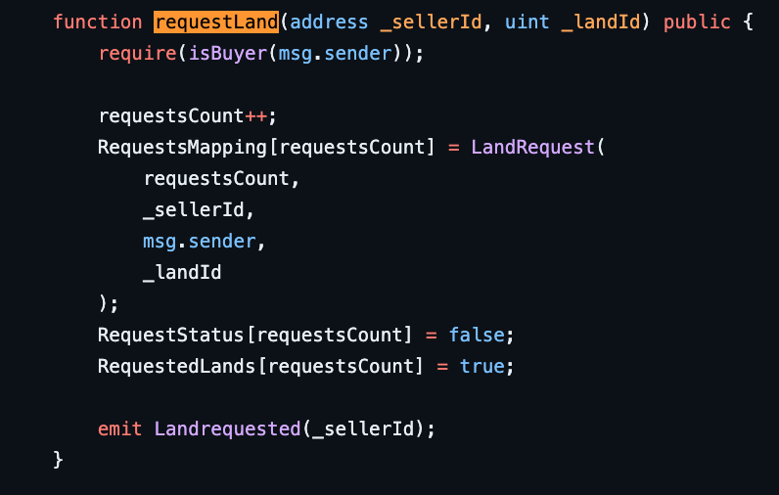
19
3. requestLand(): This function is used when a potential buyer requests a property from a seller.
This emits a Landrequested event to be triggered
INTRO
SOLUTION
METHODOLOGY
LIVE DEMO
CONSIDERATIONS
CHALLENGES
CONCLUSION

Slide 19
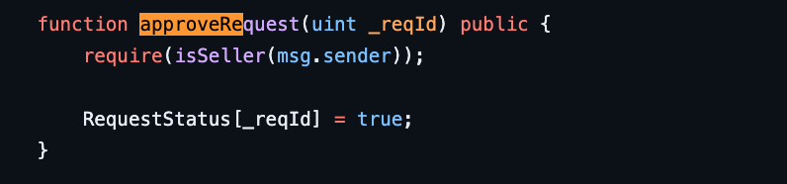
20
4. approveRequest(): Seller approves the request to sell his property to buyer who has requested land.
- State of RequestStatus changes from ‘false‘ to ‘true‘
State
STate
INTRO
SOLUTION
METHODOLOGY
LIVE DEMO
CONSIDERATIONS
CHALLENGES
CONCLUSION

Slide 20
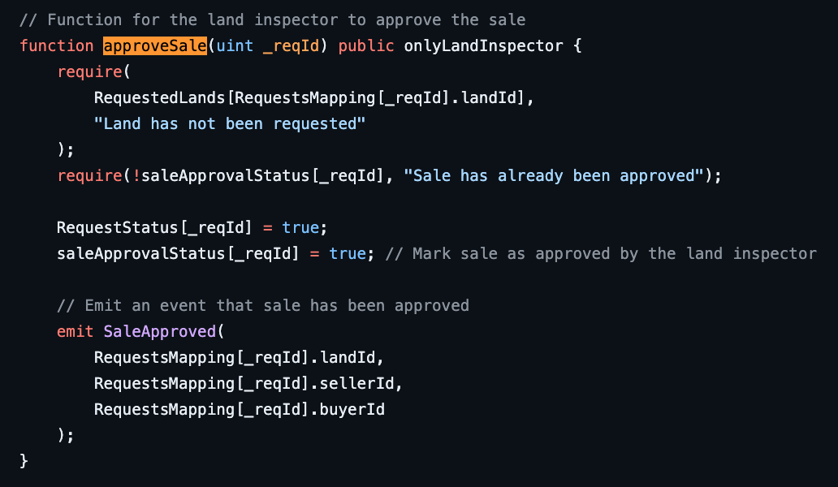
21
5. approveSale(): This function is userd when a LandInspector approves the sale of land before property is transferred from seller to buyer.
- Emits a SaleApproved event.
Emit
INTRO
SOLUTION
METHODOLOGY
LIVE DEMO
CONSIDERATIONS
CHALLENGES
CONCLUSION

Slide 21
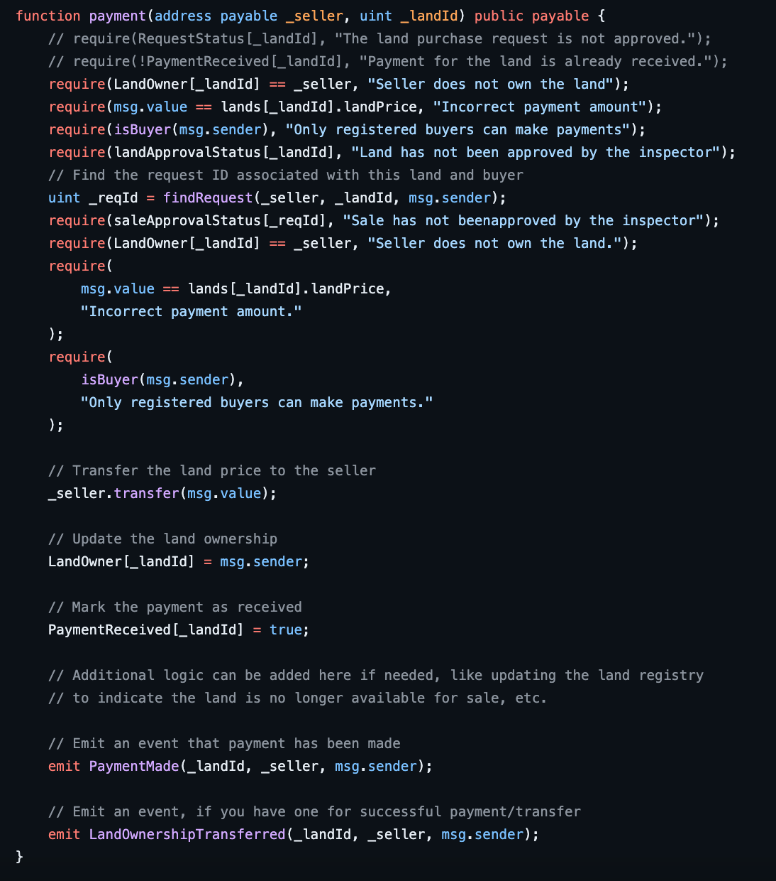
22
6. payment(): Ensures payment is completed by buyer to seller before the asset is transferred
INTRO
SOLUTION
METHODOLOGY
LIVE DEMO
CONSIDERATIONS
CHALLENGES
CONCLUSION

Slide 22
23
PROCESS OF BLOCKCHAIN DEPLOYMENT
Step 1: Set up the Smart Contracts
Solidity Smart Contract:
The project utilizes a Solidity smart contract called "Land.sol"
This contract is responsible for handling the transfer of property and maintaining a decentralized and tamper-proof land registry.
INTRO
SOLUTION
METHODOLOGY
LIVE DEMO
CONSIDERATIONS
CHALLENGES
CONCLUSION

Slide 23
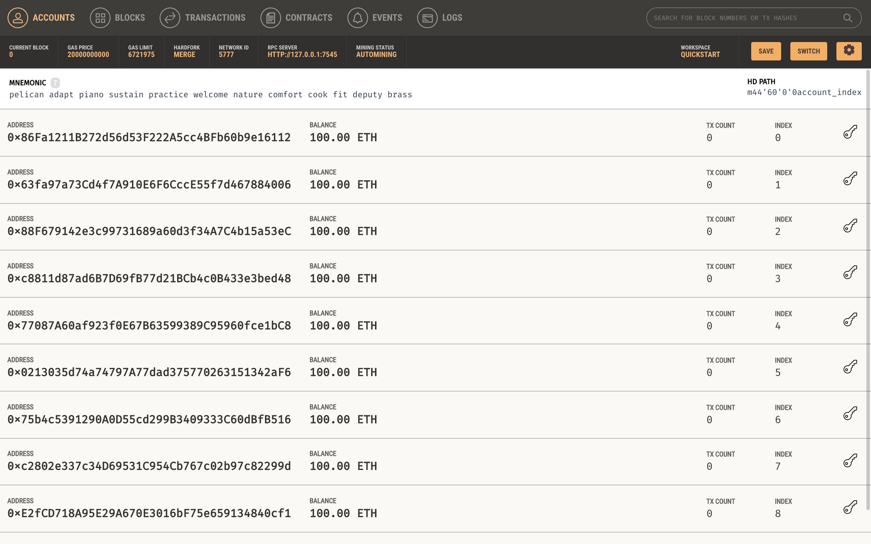
24
PROCESS OF BLOCKCHAIN DEPLOYMENT
Step 2:
Set up the Truffle Suite - Ganache
Setup some test accounts with initial ETH balance.
Gas fee is a commonly used term for the cost that certain blockchain protocol users pay to network validators each time they wish to perform a state change in the contract.
INTRO
SOLUTION
METHODOLOGY
LIVE DEMO
CONSIDERATIONS
CHALLENGES
CONCLUSION

Slide 24
25
LIVE DEMONSTRATION
INTRO
SOLUTION
METHODOLOGY
LIVE DEMO
CONSIDERATIONS
CHALLENGES
CONCLUSION

Slide 25
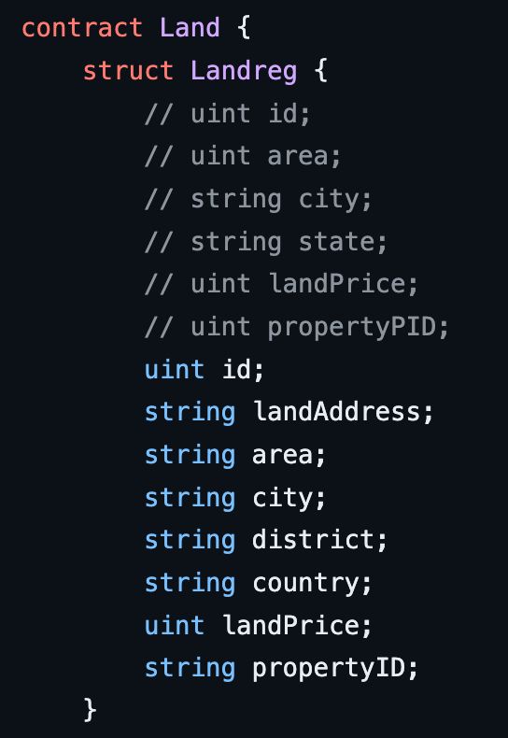
26
SECURITY DESIGN
Key Questions:
How to ensure each property is added only once ?
INTRO
SOLUTION
METHODOLOGY
LIVE DEMO
CONSIDERATIONS
CHALLENGES
CONCLUSION

Slide 26
27
SECURITY DESIGN
Key Questions:
2. How to make sure of user identity ?
HKID Verification with OTP
Facial ID Verification with HKID similar to the one in bank account opening / using HKSAR Govt. Services
INTRO
SOLUTION
METHODOLOGY
LIVE DEMO
CONSIDERATIONS
CHALLENGES
CONCLUSION

Slide 27
28
SECURITY DESIGN
Key Questions:
3. How to make sure payment is transferred ?
Verify that the contract has sufficient balance to cover the payment amount.
We use a robust transfer method like send or call.value to handle potential transfer failures.
Handle any errors or exceptions that may occur during the transfer process.
Thoroughly test the payment functionality in different scenarios and edge cases.
Validated the contract's behavior on a testnet or in a local development environment.
INTRO
SOLUTION
METHODOLOGY
LIVE DEMO
CONSIDERATIONS
CHALLENGES
CONCLUSION

Slide 28
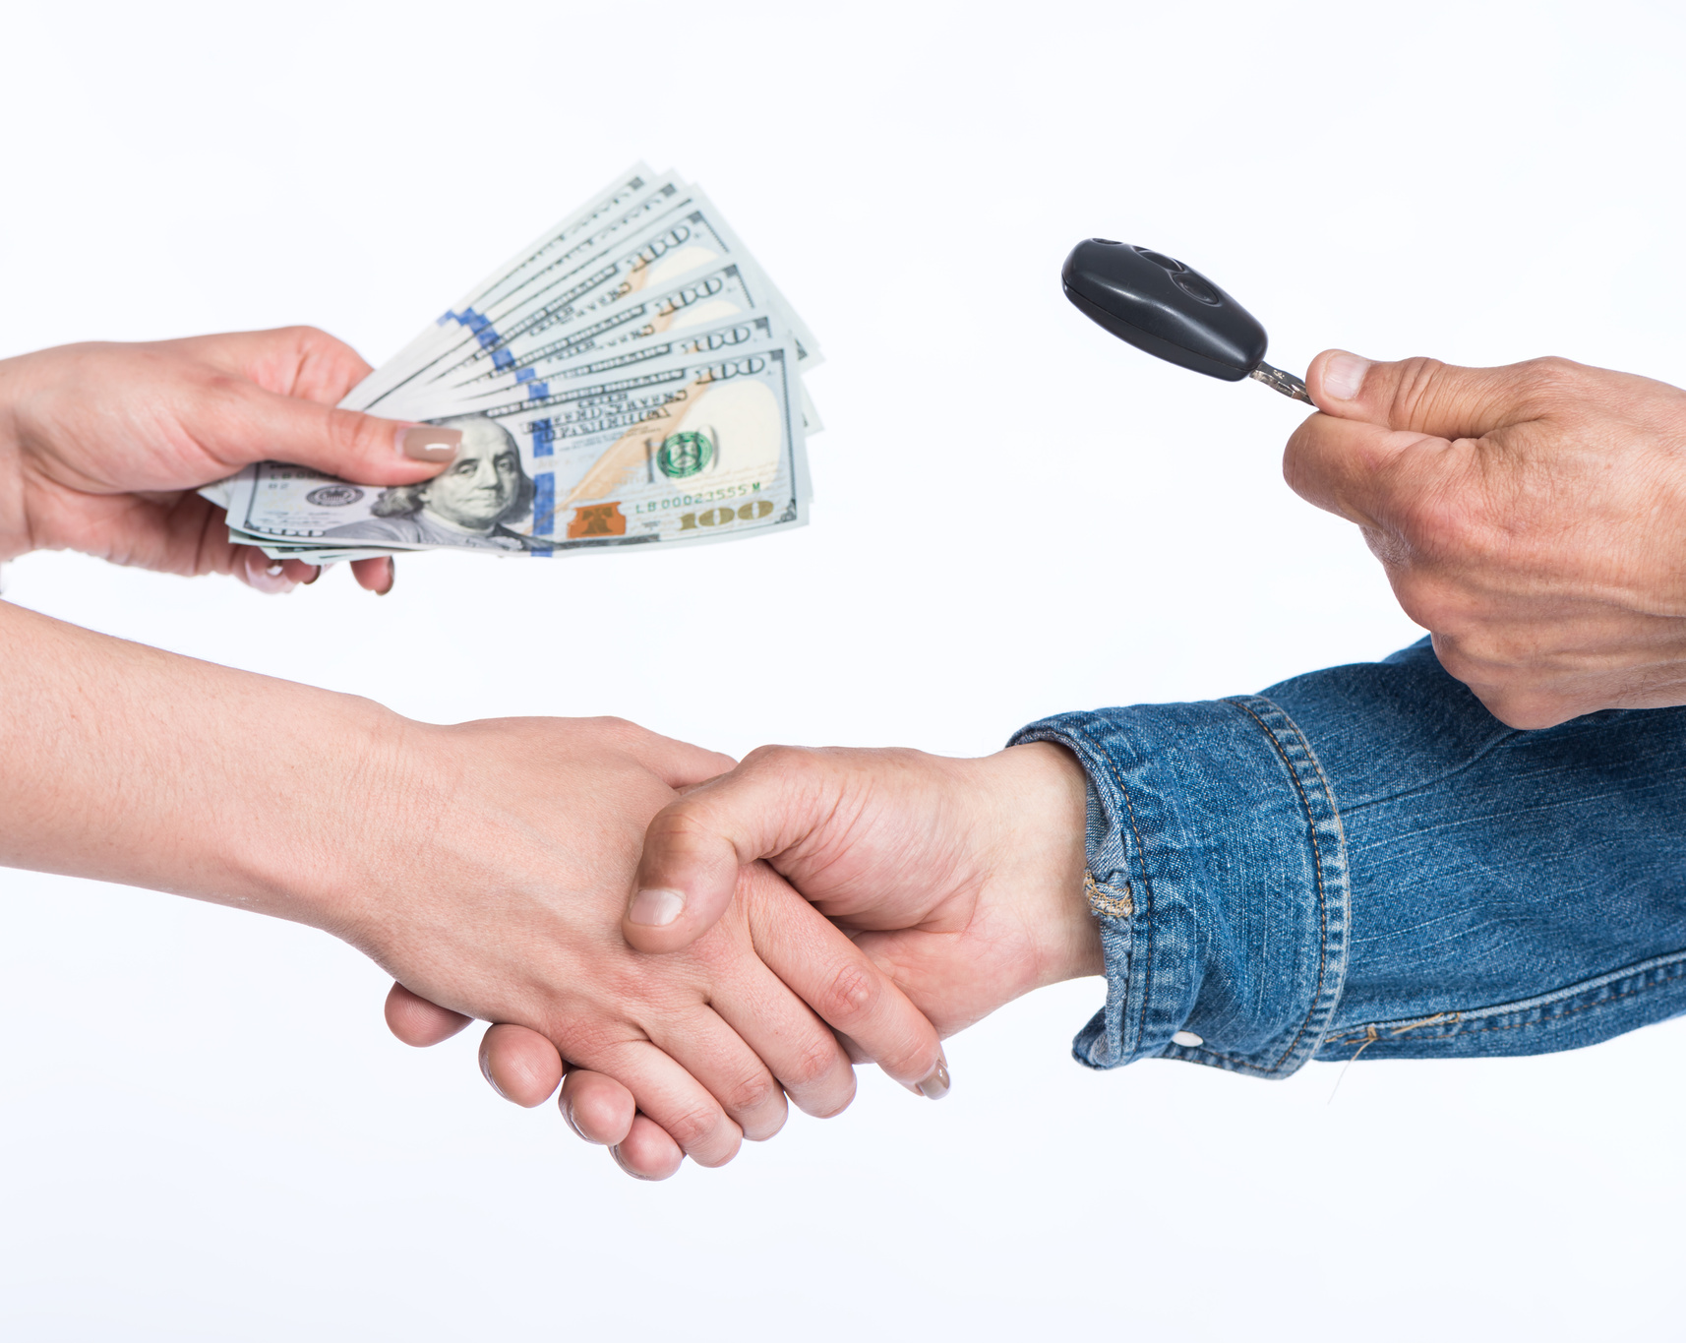
29
SECURITY DESIGN
Key Questions:
4. Can you sell to yourself.
Simple Answer = No
Checks in-place to make sure the transaction happens from a unique user to a different unique user.
INTRO
SOLUTION
METHODOLOGY
LIVE DEMO
CONSIDERATIONS
CHALLENGES
CONCLUSION

Slide 29

30
TESTING AND FEEDBACK
TYPES OF REAL ESTATE
INVESTMENTS
TESTING STRATEGIES EMPLOYED
FEEDBACK MECHANISMS USED
Stress Testing
Feedback Sessions
Tested system performance under varied load conditions to confirm stability and scalability.
Organized casual feedback sessions with friends and fellow students to gain deeper insights and discuss potential enhancements.
Usability Testing
Regular Update Meetings
Engaged peers in testing the interface, collecting insights to improve user interaction and design.
Met regularly with our project group to review feedback and decide on necessary adjustments.
INTRO
SOLUTION
METHODOLOGY
LIVE DEMO
CONSIDERATIONS
CHALLENGES
CONCLUSION

Slide 30

31
Government and Regulatory Bodies
Role: Ensure legal compliance and integration with current land registry systems.
Benefits: Boosts transparency, reduces fraud, enhances public trust and regulatory oversight.
STAKEHOLDER ENGAGEMENT
IN BLOCKCHAIN LAND REGISTRY
Role: Active participants in using the platform for transactions and registrations.
Benefits: Streamlined processes, reduced transaction times, and lower costs. Improved access to verified property information.
Land Buyers and Sellers
"Collaborative efforts from all stakeholders are crucial for evolving our land registration system into a modern, efficient, and transparent platform."
Technology Partners and Developers
Role: Design, develop, and maintain the blockchain system, ensuring it meets functional and security standards.
Benefits: Opportunity for innovation and leadership in blockchain applications for real estate.
INTRO
SOLUTION
METHODOLOGY
LIVE DEMO
CONSIDERATIONS
CHALLENGES
CONCLUSION

Slide 31

32
DECENTRALISED VS CENTRALISED SYSTEMS
IN LAND REGISTRY
Centralized Systems
Decentralized Systems (Blockchain)
Pros:
Central control and oversight.
Simplified governance structure.
Cons:
Higher risk of fraud and data tampering.
Single point of failure can lead to system-wide disruptions.
Pros:
Improved security
Greater transparency and reduced fraud risk.
Quicker transactions by removing intermediaries.
Cons:
Requires more technical infrastructure and understanding.
Potential scalability issues as the network grows.
INTRO
SOLUTION
METHODOLOGY
LIVE DEMO
CONSIDERATIONS
CHALLENGES
CONCLUSION

Slide 32

33
REAL WORLD IMPLICATIONS
IS IT FEASIBLE IN THE REAL WORLD?
Scalability and Network Infrastructure
Technical Compatibility
Regulatory Compliance
Full compliance with data protection and privacy regulations:
Robust security measures
Efficiently handles high volume
Robust and reliable infrastructure
Readily accessible platform
Smooth transition with existing systems
Compatibility with diverse applications
INTRO
SOLUTION
METHODOLOGY
LIVE DEMO
CONSIDERATIONS
CHALLENGES
CONCLUSION

Slide 33
35
CHALLENGES AND LESSONS LEARNED
CHALLENGE FACED
LESSON LEARNED
Technical Complexity:
Mastering blockchain technology was initially daunting due to its novelty and the depth of technical knowledge required.
Embrace Continuous Learning:
The fast-evolving nature of blockchain technology taught us the importance of staying updated and adaptable.
INTRO
SOLUTION
METHODOLOGY
LIVE DEMO
CONSIDERATIONS
CHALLENGES
CONCLUSION

Slide 34
36
CHALLENGES AND LESSONS LEARNED
CHALLENGE FACED
LESSON LEARNED
Regulatory Uncertainty:
Adapting to evolving legal frameworks that govern digital assets and blockchain technology proved challenging.
Proactive Regulatory Alignment:
We aligned closely with existing regulatory frameworks early on, enabling us to anticipate compliance challenges and adapt our development process.
INTRO
SOLUTION
METHODOLOGY
LIVE DEMO
CONSIDERATIONS
CHALLENGES
CONCLUSION

Slide 35
37
CHALLENGES AND LESSONS LEARNED
CHALLENGE FACED
LESSON LEARNED
Technical Interoperability:
Ensuring that our blockchain solution could interact seamlessly with various other technology systems and platforms.
Emphasizing Technical Flexibility:
We learned the importance of designing systems with adaptability in mind, allowing for easier integration with other technologies and future upgrades.
INTRO
SOLUTION
METHODOLOGY
LIVE DEMO
CONSIDERATIONS
CHALLENGES
CONCLUSION

Slide 36

38
FUTURE PROSPECTS AND SUGGESTIONS
TOKENISATION OF REAL ASSETS
Introduction
Representing real-world assets, such as properties, as digital tokens on the blockchain.
Benefits of Tokenization
Enhanced Liquidity:
Accessibility:
Partial Ownership of Real Estate.
INTRO
SOLUTION
METHODOLOGY
LIVE DEMO
CONSIDERATIONS
CHALLENGES
CONCLUSION

Slide 37
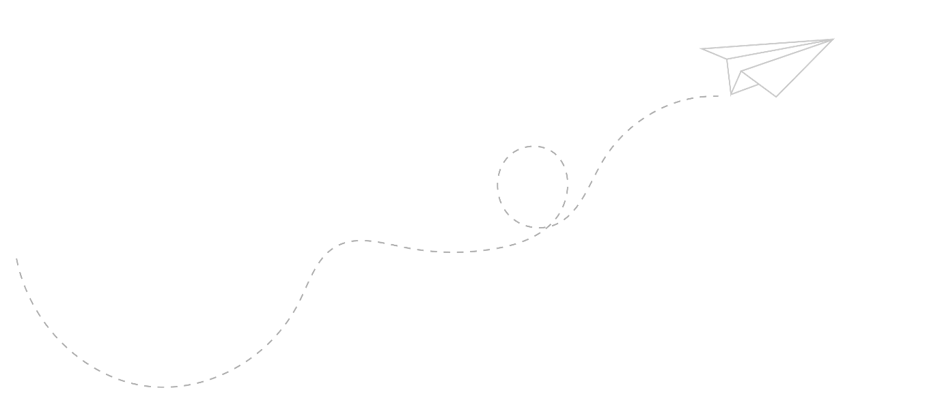
39
CONCLUSION
Next Steps
Further Testing and
Real World
Implementation
Future Outlook
Total Asset
Digitalization
Blockchain Revolution
Property Transaction
Transformation
Achievements
Ready to launch
MVP
INTRO
SOLUTION
METHODOLOGY
LIVE DEMO
CONSIDERATIONS
CHALLENGES
CONCLUSION

Slide 38
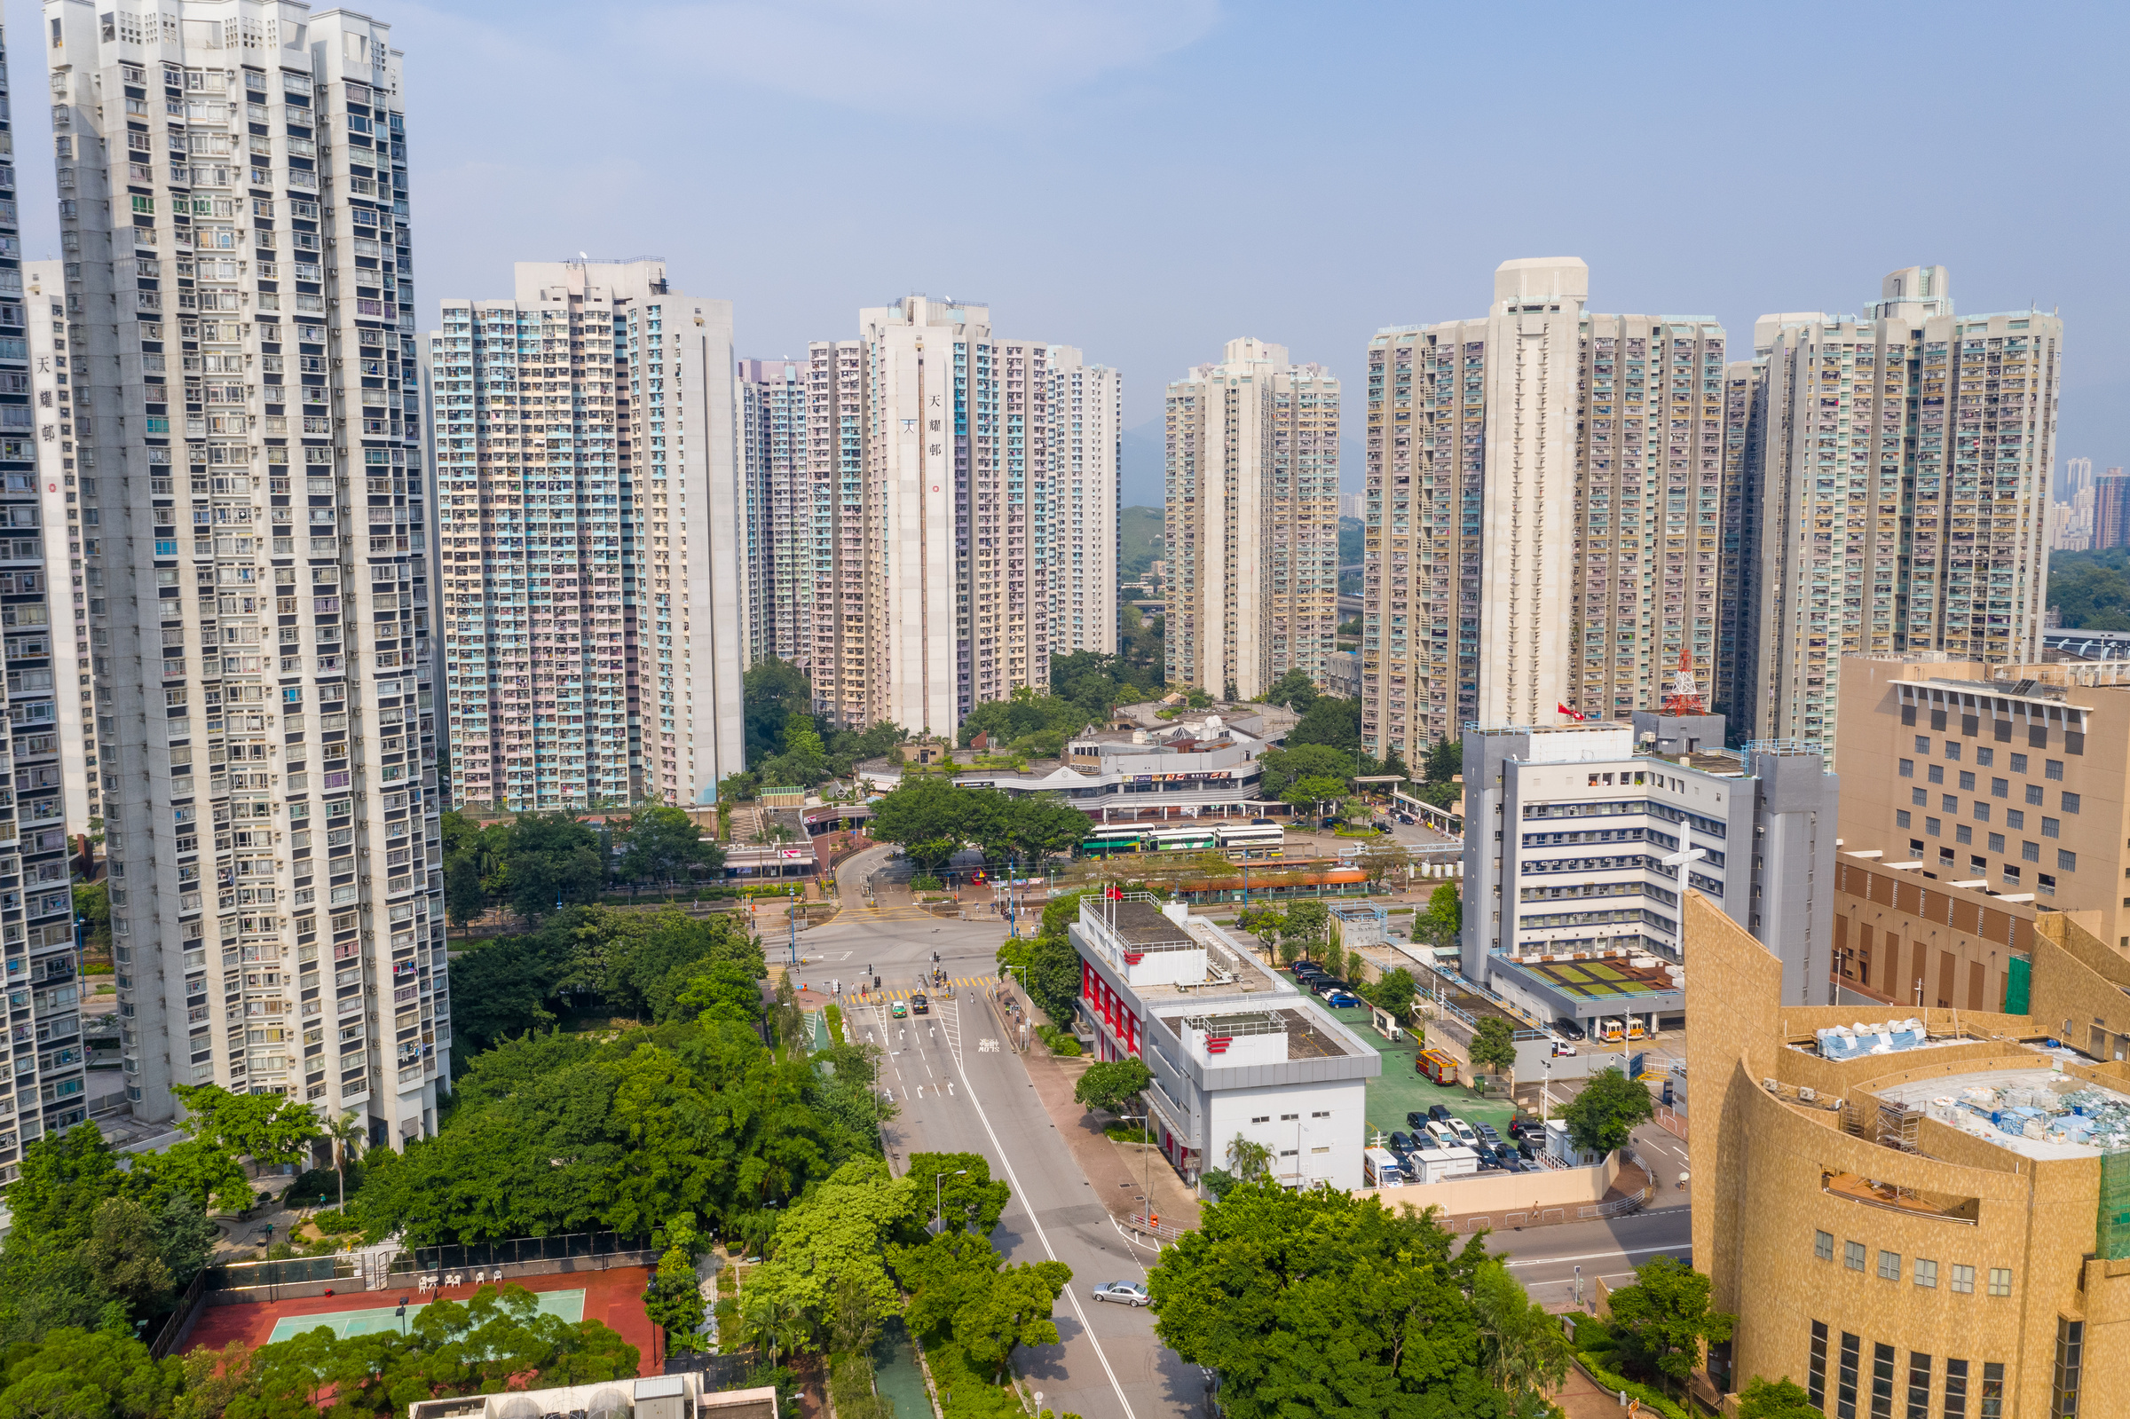
40
NOTE OF THANKS
LIVE DEMO
LIVE DEMO
CHALLENGES
INTRO
CHALLENGES
INTRO
SOLUTION
SOLUTION
METHODOLOGY
CONSIDERATIONS
CONSIDERATIONS
CONCLUSION
CONCLUSION

Slide 39

41
QUESTIONS?
INTRO
SOLUTION
METHODOLOGY
LIVE DEMO
CONSIDERATIONS
CHALLENGES
CONCLUSION

